Slide 1
Version Control Systems
Ganesh Palnitkar

Slide 2
Agenda
Importance of Version Control System
Types of Version Control Systems
Distributed VCS
Centralized VCS
Importance of Branching and merging
Branching and Merging strategies
Learning GIT – Common commands
Learning Subversion (SVN)

Slide 3
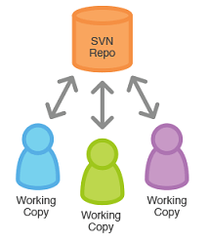
About Version Control Systems
Version control software is an essential part of the every-day of the modern software team's professional practices.
Version control software keeps track of every modification to the code in a special kind of database.
Version control protects source code from both catastrophe and the casual degradation of human error and unintended consequences.
Helps teams to solve problems like, tracking every individual change by each contributor and helping prevent concurrent work from conflict.
Conflicts if any should be solved using help of tool or manually.
Benefits:
No need to keep multiple backups.
Allows multiple people to work on same file / project.
A complete long-term change history of every file.
Branching and merging – maintain code as per projects / release / functionality etc.
Traceability - ability to trace each change made to the software and connect it to project management and bug tracking software.
Easily switch / work on earlier file versions.

Slide 4
Types of Version Control System
Centralized VCS:
Workflow:
Pull down any changes other people have made from the central server.
Make your changes, and make sure they work properly.
Commit your changes to the central server, so other programmers can see them.
Benefits:
Project history and database is maintained on centralized server, beneficial incase of large project size and history.
Disadvantages:
Internet / network connection is must.
Frequent (daily) database sync is necessary.
Pull and push to centralized server can be time taking.
e.g. : SVN, TFS, Perforce
Distributed VCS
Workflow:
Clone entire repository on local machine.
Maintain all code changes on local machine.
Incase of sharing the code with others, merge the code on central GIT repo.
Benefits:
Extremely fast, as database resides on local drive.
Committing to a changeset can be done locally. Group of changesets then can be pushed to remote repository.
No need of internet connection.
Disadvantages:
The only major one can be because of large project history / size. Initial cloning and maintaining huge database can eat up space on local machine.
Database backup should be done locally.
e.g. GIT, Mercurial
Server
repo
Client
Client
Centralized VCS
Client / Local
repo
repo
Client / Local
Client / Local
repo
Distributed VCS

Slide 5
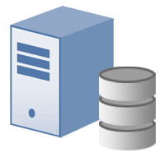
Distributed VCS
User A as the first user / Developer in the team to start coding.
User A
User B
Local repo
Local repo
User A creates a local repository on his local machine / development environment. Local version control operations
commit
pull
push
commit
pull
clone
User B joins the team to speed up the development work. He asks for a base code copy from User A.
push
Remote repository (GITHUB)
User A creates a remote repository on GitHub / GitLab and Push the code to remote repo.
User B makes a clone of remote repo, a particular ranch to his / her local machine and gets a local repo created.
clone
User C
Local repo
Later User C is asked to work on a new feature.
User C makes a clone of remote repo, a particular ranch to his / her local machine and gets a local repo created.
DVCS
commit

Slide 6
Centralized VCS
A centralized repository on a central server (SVN) is created.
VCS Server
Developers / users will make a pull / checkout from the central repository.
Over Network / internet
Only latest version is pull / checked out in to local workspace on the developer’s machine.
Check-in
Check-out
User A – working copy / Client software
User B – working copy / Client software
Users / Developers will continue to check-in and check-out from central server to local workspace
CVCS

Slide 7
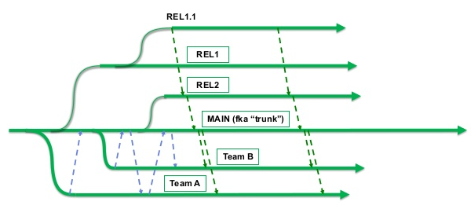
Branching and Merging strategies
Brach by release, “staircase model”.
Branch by feature. Each distinct branch.
Hotfix branch.
Best practices:
Keep option of branching only if required, keep it simple.
Incase of centralized VCS, merging should be done frequently / sooner (daily recommended)
Use tagging as and when required.
Delete unwanted branches.
Identify shared components in details and in advance.
Merge only when your branch is compliable and stable.
Branching and merging scenario
Master
C0
C1
C2
C4
Common Ancestor
Snapshot to Merge
C3
C5
Feature
Simple Branching and merging in GIT project

Slide 8
GIT - DVCS
GIT has bash /command-line interface and GUI as well.
Git is a distributed VCS. Provides extremely fast operation. Does not need centralized server. Once the entire repository is pulled on local machine, network / internet connection is not required for most of the VCS operations.
GIT works on most of the OS platforms (OSx, Windows, Unix / Linux).
On installation, the GIT config should be run to configure user name, email ID, etc.
In order to start using the VCS, the folder that you want to version control, run the command ‘git init’. This enables the VCS and tracking of file changes in the folder.
GitHub
Remote Repository
fetch
Push
Local Repository
pull
commit
Staging area
add
Working area: similar to work area, development environment.
Working directory
Staging area: where you store a place a snapshot before committing changes to the local repo.
Local GIT repository
Local repo: is a copy of remote repository. This is where you have all versioning of data/code/artifacts maintained.
Download ‘git’ from, http://git-scm.com
Remote repository: this can be the GitHub repository or a remote repository maintained on a server on intranet.

Slide 9
GIT – Branching Strategies
Master
Master
Branching / merging scenario for Multiple development tracks with hotfix
To rename a remote repository,
git remote rename <remote-name><URL>
Verify after renaming,
git remote –v
To delete existing remote,
git remote rm <url>
git remote –v
To push commits made to local repo onto remote repo,
git push origin master
git push <remote name> <branch>
To push local branch to remote branch and rename remote,
git push <remote-name><local branch>:<remote branch-name>
code
Feature 1
Feature 2
code
Master 1.0
Code 1
Code 2
Master 1.1
Feature 1
Feature 2
Feature 1.1
Feature 2.1
Master 2.0
Code 1
Code 1
Code 2
Master 1.2
Code 1
Code 2
Branching and merging for Multiple development tracks
Feature 1
Feature 2
Master 1.2

Slide 10
GIT common Commands
Below are certain commands that are used often while we use ‘GIT’.
git status → provides status of changed, created, deleted files objects
git add → indexing done for selected or all files and added to staging area
git rm –cached → to remove file added to staging area
git commit –m “comment” → final commit of object to local repo database
git log --graph -p → use ‘shift+z’ to come out of the log
git diff → provides info about what has changed in the file
git diff --cached → diff for the files in the staging area.
git branch → provides list of all branches
git branch <branch name> → to create a branch
git remote add <name> <url> → to add remote repo ref.
git checkout <branch name> → switch to mentioned branch
git clone <https://remote repo> → clone from remote repo.
git pull <repo name> <branch name> → pull updates for defined branch from remote repo
Always perform a ‘Pull’ action before ‘pushing’ the code to remote repo.

Slide 11
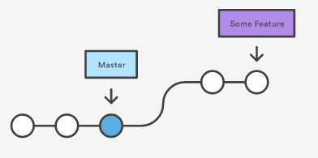
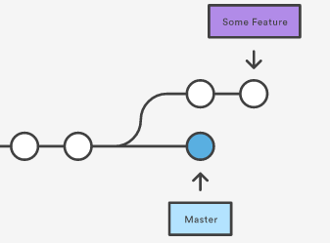
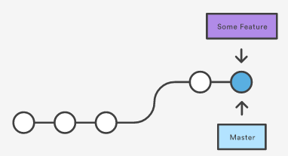
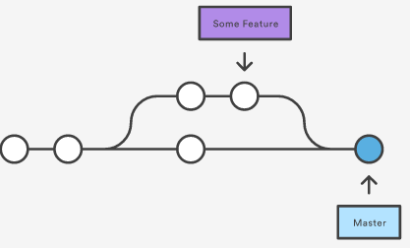
GIT Merge operations
Fast-forward Merge
3-way or Recursive Merge

Slide 12
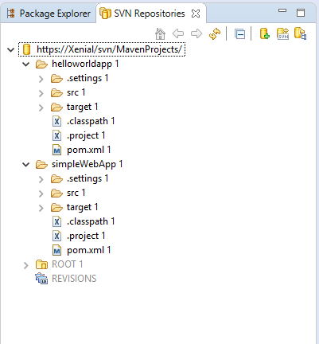
Subversion (SVN) - VCS
Easy to use and most favorite among developer community.
Open Source under apache project.
To start with,
Identify a machine to install SVN server.
Tortoise SVN is a client software used for connecting to SVN server.
The client has repository browser.
Default folder structure involves,
Trunk --- development activities
Tags ---- a label for released version
Branches --- release activities
All development work is carries out in trunk folder. Once the code is ready for release a branch is created in branches as ‘release-1’ (example) and once the code is moved to production a tag is created as a label for the released version.
For various hotfix activities a branch is derived from the tag.
SVN has PowerShell plugin for scripting and automation, enables automated version control operation while integrating or moving through development activities.
VisualSVN supports HTML5, repositories can be accessed over web.
Subversive SVN plug-in: helps to provide team explorer view of project repository

Slide 13
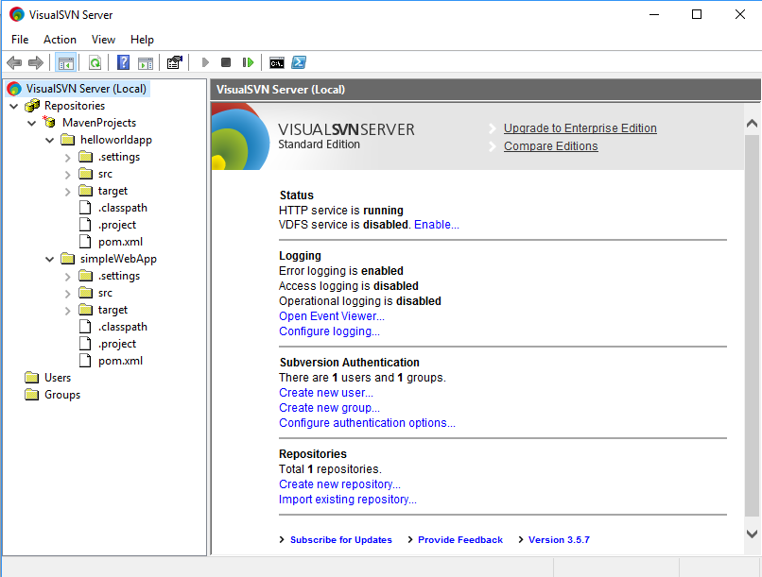
Subversion (SVN) - VCS
VisualSVN Server is a freeware Apache Subversion server package for Windows.
Features:
Active directory single sign-on: allows user to access SVN repository with their windows active directory credentials.
Provides remote server administration access.
Multisite repository replication: Using SVN distributed file system to fast replicate VCS database across geographically separated servers.
Repository management delegation: can delegate repository management to non-administrator user.

Slide 14
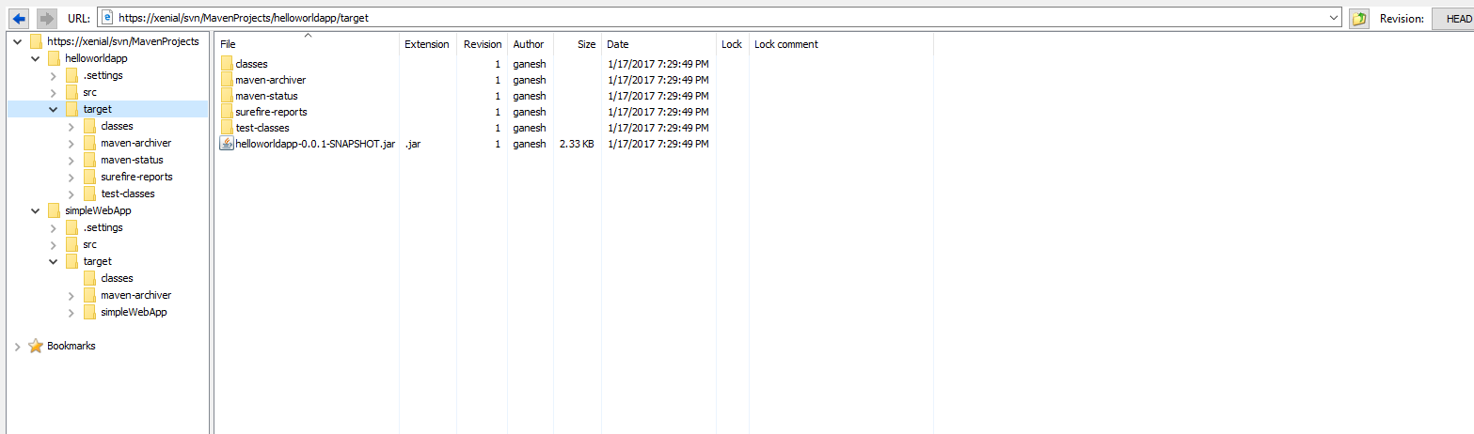
Subversion (SVN) - VCS
Repository Browser View of a project repository

Slide 15
Thank You

